Slide 1
Lecture 4:
Cellular Oncogenes (细胞癌基因)
Oct 20, 2023
Notes:
上节课回顾了肿瘤研究从1910s-1980s的历史，肿瘤起因的传染病学说，非传染病学说，病毒起因最后讲到著名的Varmus-Bishop 实验，提出正常细胞内存在没有激活的proto-oncogene理论，为肿瘤研究指明了正确道路…

Slide 2
Oncogene （癌基因） is a gene that has the potential to cause cancer.
proto-oncogene （原癌基因） is a normal gene that could become an oncogene due to mutations or increased expression.
How proto-oncogene become oncogene?

Slide 3
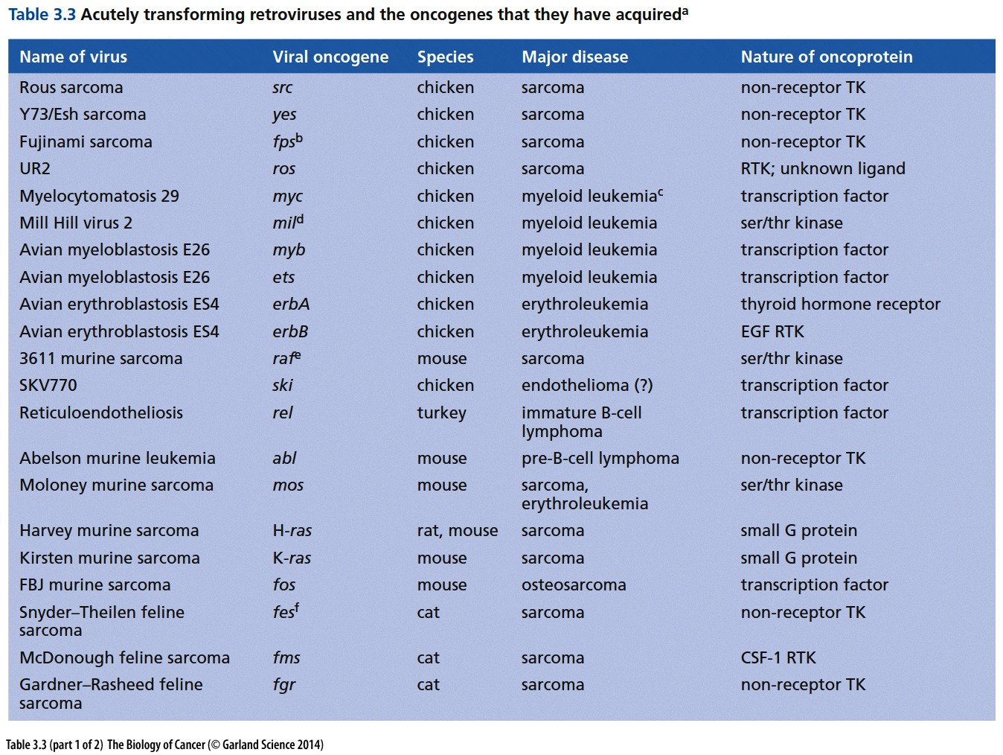
Notes:
注意几乎所有这些快速致肿瘤病毒来源于非人的物种。。。
判定一个基因是不是oncogene的金标准之一：有没有发现携带该基因的致癌retrovirus

Slide 4
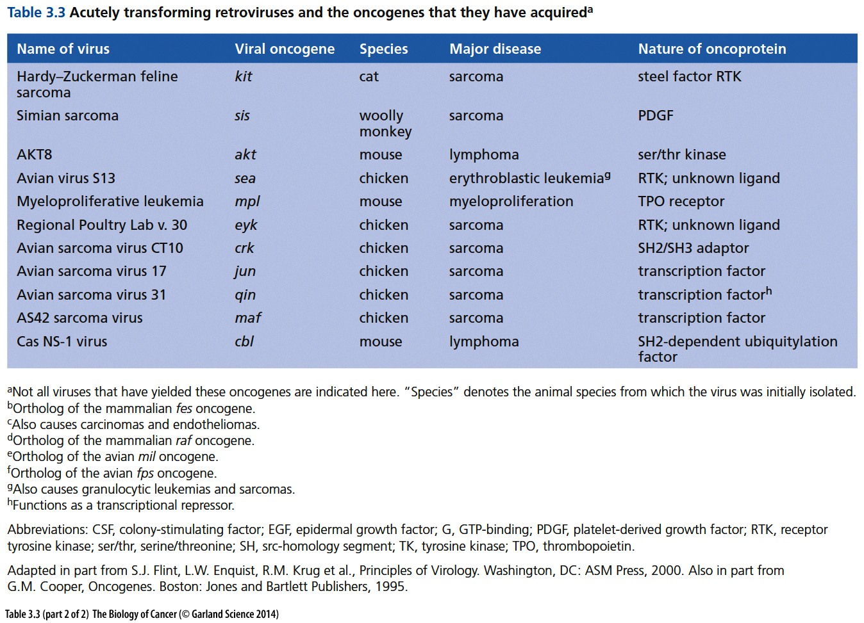

Slide 5
Outline of today`s lecture
1. Collapse of cancer initiation by endogenous retrovirus theory
2. Identify non-viral oncogene by DNA transfection
3. Many non-viral oncogene are related to those found in transforming virus
4. Multiple ways to generate oncogene from proto-oncogene
Notes:
本章有三个重要的实验……

Slide 6
Gene/protein naming rules
Nonhuman oncogenes are usually written as uncapitalized three-letter words in italics (for example, myc), while their protein products are written in roman font with an initial capital (for example, Myc). The myc proto-oncogene itself is often termed c-myc to distinguish it from its two cousin genes, N-myc and L-myc. To make matters more confusing, human genes follow a different nomenclature, so that the human myc gene is denoted as MYC and its protein product is written as MYC. We will generally use the nonhuman acronym conventions in this book.
All gene name: 斜体; All protein product: 正体;
Virus gene: 全部小写 myc；
Mouse gene: 首字母大写余下小写 Myc；
Human gene: 全部大写 MYC .
Notes:
命名规则

Slide 7
Bio techniques mentioned in today`s lecture
Gene transfection (转染),
Southern blot,
Northern blot,
Western blot,
Fluorescence in situ hybridization (FISH),
Notes:
上节课讲了细胞培养常识，DMEM是什么？FBS作用是什么？5%CO2作用是什么？ 这节课讲以下几种试验技术。。。

Slide 8
4.1 Can cancers be triggered by the activation of endogenous retroviruses(内源逆转录病毒)?
Notes:
1966年Rous拿到诺贝尔奖后, 学术界的主流观点认为病毒，尤其是逆转录病毒，是肿瘤发生的关键因素。现在我们知道这个观点基本错误……

Slide 9
Viral origin of the majority of malignant tumors?
Endogenous proviruses are transcriptionally silent, and their presence in all of the cells of an organism is not apparent. On rare occasions, however, it is possible to awaken the expression of such latent endogenous proviruses, which often retain the ability to encode infectious retrovirus particles, and leads to the transformation of cells.
Mutagenic carcinogens, such as those present in tobacco tar, might provoke the activation of previously latent endogenous retroviruses. The resulting virus particles would then begin multiplying, spread throughout an individual’s body, and, like the endogenous retroviruses in some mouse strains, cause cancers to form in one or another susceptible tissue.
Cancer theory of 1970s`
Notes:
第一章讲到人基因组中超过90%的序列不编码，有约8%的序列是以前病毒感染留下的序列……

Slide 10
Problems of the viral origin theory of cancer
1. Reports of infectious retroviral particles in human tumors could not be verified.
2. Even reverse transcriptase–containing virus particles were difficult to find in human tumors.
3. Most endogenous retroviral genomes present in the human genome are no longer capable of specifying infectious retrovirus particles and thereby joined the ranks of the junk DNA sequences that form the bulk of our genome.

Slide 11
In 1970s:
The majority of human malignant tumors were caused by virus
“The viral origin of the majority of all malignant tumors … has now been documented beyond any reasonable doubt. It … would be rather difficult to assume a fundamentally different etiology for human tumors.”
Ludwik Gross, tumor virologist, 1970
Actually
Most types of human cancer clearly do not spread from one individual to another as an infectious diseases.
Only two commonly occurring tumor types in the Western world- cervical carcinomas and hepatomas (liver carcinomas) – could clearly be tied to specific viral causative agents.

Slide 12
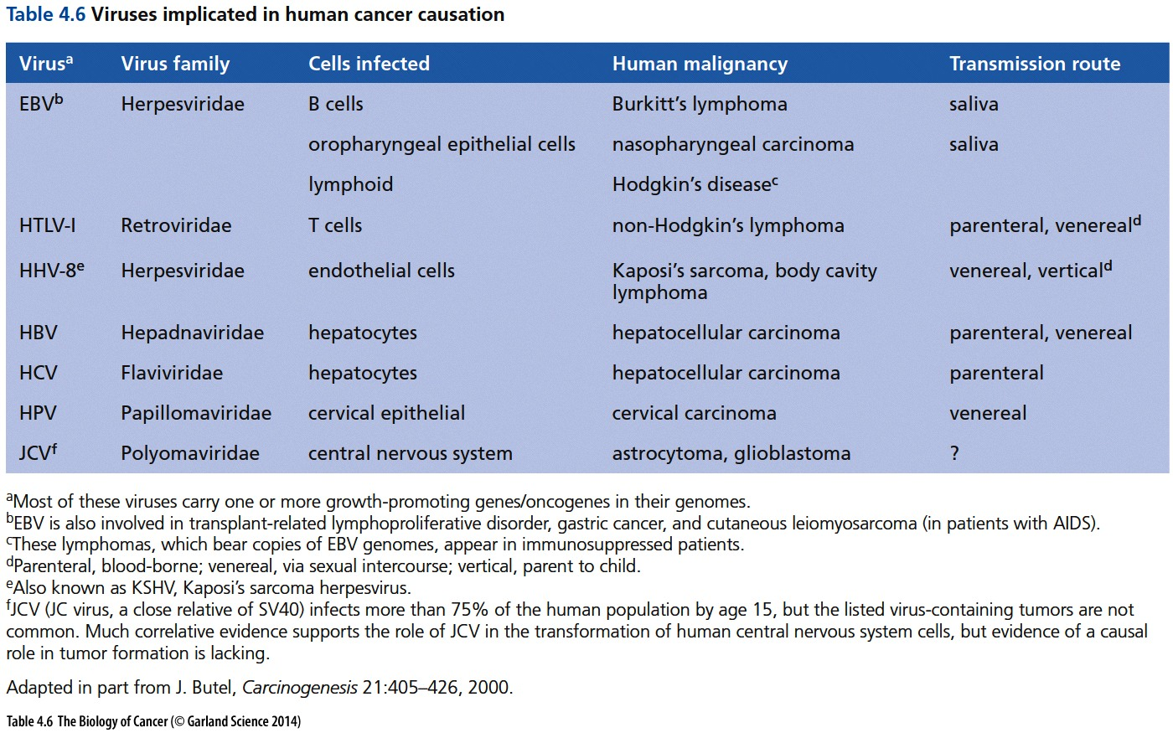

Slide 13
Non-viral agents that cause tumor
Research begun in Japan by Katsusaburo Yamagiwa in the first decade of the twentieth century revealed that chemical agents could induce cancers in laboratory animals. As mentioned earlier, his work showed that repeated painting of coal tars(煤焦油) on the ears of rabbits yielded skin carcinomas after several months’ time.
By the middle of the following decade (1910s), a PhD thesis in Paris documented more than a hundred cases of human cancer, largely of the skin, in individuals who had worked with X-ray tubes. In both cases, it was clear that the agents that directly provoked the tumors were non biological, being either organic chemicals or radiation.
Notes:
肿瘤病毒起源这个理论失败了，那么肿瘤的起因到底是什么。。。

Slide 14
Does non-viral agents stimulate cancer through same or different oncogene as virus induced cancer?
4.2 Transfection of DNA provides a strategy for detecting non-viral oncogenes

Slide 15
Techniques for DNA transfection(转染)
In 1972, a highly effective gene transfer procedure, soon termed transfection, was developed. This procedure, which made possible the introduction of naked DNA molecules directly into mammalian cells (Figure 4.1), was based on co-precipitation of DNA with calcium phosphate(磷酸钙) crystals. For reasons that remain poorly understood to this day, these co-precipitates could overcome the natural resistance of cells to taking up foreign genetic material. Cells of the NIH 3T3 cell line, derived originally from mouse embryo fibroblasts（鼠胚胎成纤维细胞）, turned out to be especially adept at taking up and integrating into their genomes the foreign DNA introduced in this fashion.
Notes:
Transduction vs transfection：virus based is transduction; DNA based is transfection; 正常细胞对外源DNA有天然的抵抗性， 如何突破这个抵抗？？？

Slide 16
Current cell transfection methods
calcium phosphate
electroporation
cell squeezing
cationic lipid
Most commonly used transfection reagents
Lipofection (or liposome transfection) is a technique used to inject genetic material into a cell by means of liposomes, which are vesicles that can easily merge with the cell membrane since they are both made of a phospholipid bilayer. Lipofection generally uses a positively charged (cationic) lipid to form an aggregate with the negatively charged (anionic) genetic material.
Lipofectamine® 2000 Reagent - Thermo Fisher Scientific
Notes:
Efficient delivery of mRNA vaccines will be key for their success and translation to the clinic. Among potential nonviral vectors, lipid nanoparticles are particularly promising.

Slide 17
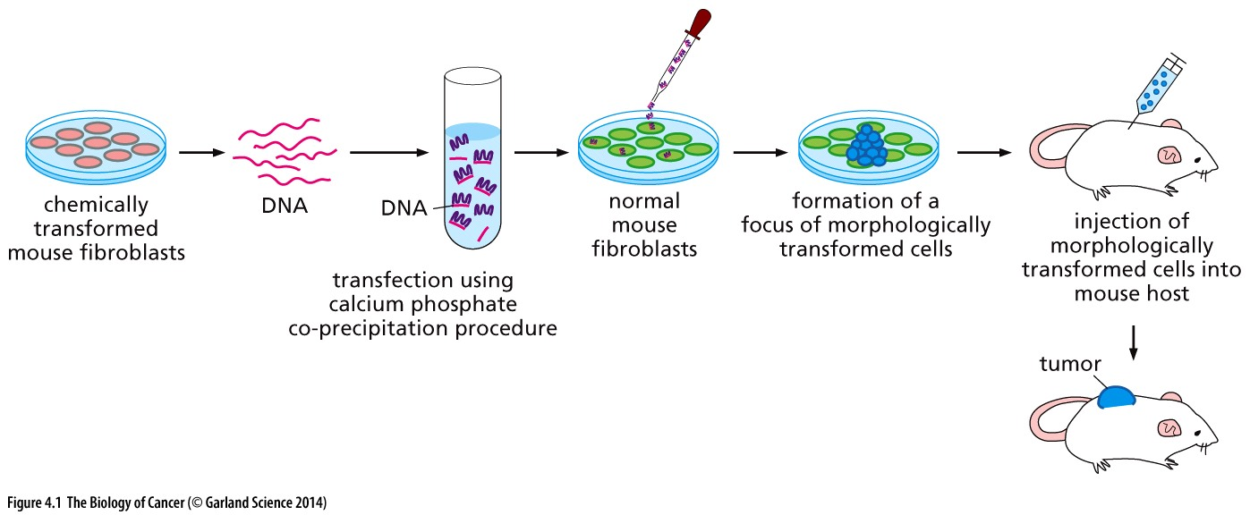
Figure 4.1 Transfection of DNA of transformed cells
DNA is then introduced into a phosphate buffer. When calcium ions are added, a co-precipitate of DNA and calcium phosphate crystals is formed (pink and purple). These crystals are added to a monolayer culture of normal cells (green). The calcium phosphate crystals facilitate the uptake of DNA fragments by cells.
Early 1980s

Slide 18
Non-viral cellular oncogene
These particular cancer cells originated with mouse fibroblasts of the C3H10T1/2 mouse cell line that had been treated repeatedly with the potent carcinogen and mutagen 3-methylcholanthrene (3-MC), a known component of coal tars. Importantly, these cells bore no traces of either tumor virus infection or activated endogenous retroviral genomes. Hence, any transforming oncogenes detected in the genome of these cells would, with great likelihood, be of cellular origin, that is, mutant versions of normal cellular genes.

Slide 19
Non-viral cellular oncogene
In 1978–1979, DNAs extracted from several such 3-MC–transformed mouse cell lines were transfected into cultures of NIH 3T3 recipient cells, yielding large numbers of foci after several weeks. The cells plucked from the resulting foci were later found to be both anchorage-independent and tumorigenic (see Table 3.2). This simple experiment proved that the donor tumor DNA carried one or several genetic elements that were able to convert a non-tumorigenic NIH 3T3 recipient cell into a cell that was strongly tumorigenic.

Slide 20
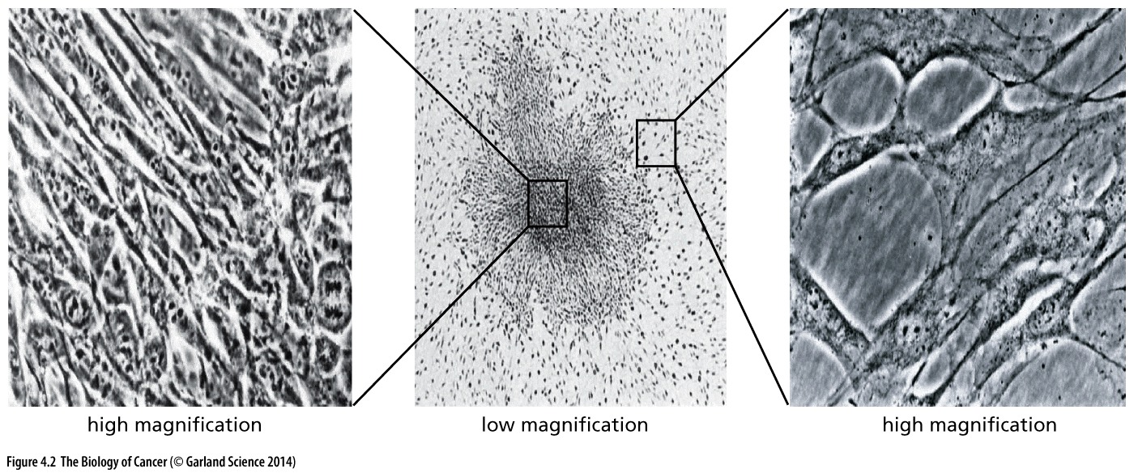
Figure 4.2 Transformation of mouse cells by human tumor DNA
The introduction via transfection of human tumor DNAs into NIH 3T3 cells yielded foci of transformants. Seen at low magnification (middle) is a focus generated by transfection of DNA from the T24 human bladder carcinoma cell line. At high magnification the transformed cells within this focus (left), like many transformed fibroblasts, are spindle-shaped, refractile(能折射的), and piled up densely on one another. At the same magnification, the cells in the surrounding monolayer of untransformed NIH 3T3 cells (right), like normal fibroblasts, have wide, extended cytoplasms and are not piled on one another.

Slide 21
4.3 Oncogenes discovered in human tumor cell lines are related to those carried by transforming retroviruses
Notes:
非常重要发现，先讲一下这个发现应用的一项技术：Southern Blot

Slide 22
Supplementary Sidebar 4.3 Southern and Northern blotting
Southern blotting was invented in 1975 by the British biologist Edwin Southern as a means of detecting specific DNA fragments that are generated by restriction enzyme cleavage of DNA; these fragments may be present amid a million fold excess of other concomitantly generated DNA fragments, revealing the sensitivity of this procedure (Figure S4.3). Within several years, the procedure was adapted to detect specific mRNA molecules, once again present amid a vast excess of unrelated molecules, in this case other mRNA species; for want of a better name, this newer procedure was dubbed Northern blotting. Thereafter, a further adaptation of the procedure was developed in order to detect individual proteins amid a vast excess of unrelated proteins and termed the Western blotting procedure (not shown here). While the Southern and Northern blots use radiolabeled nucleic acid probes, the Western blotting procedure uses specific antibodies, usually monoclonal antibodies, to detect proteins that have been adsorbed to filters and for this reason is also termed immunoblotting.

Slide 24
Use of DNA probes specific for the retrovirus-associated oncogenes provided the answers in short order. Using the Southern blot procedure, a DNA probe derived from the H-ras oncogene present in Harvey rat sarcoma virus was able to recognize and form hybrids with the oncogene detected by transfection in the DNA of a human bladder carcinoma cell (Figure 4.3). A related oncogene, termed K-ras from its presence in the genome of Kirsten sarcoma virus, was able to anneal with the oncogene detected by transfection of DNA from a human colon carcinoma cell line.
Notes:
非常重要发现，Ras oncogene 在一系列的转染试验中被选择性保留，并且与病毒癌基因高度同源！Weinberg 实验室发现

Slide 25
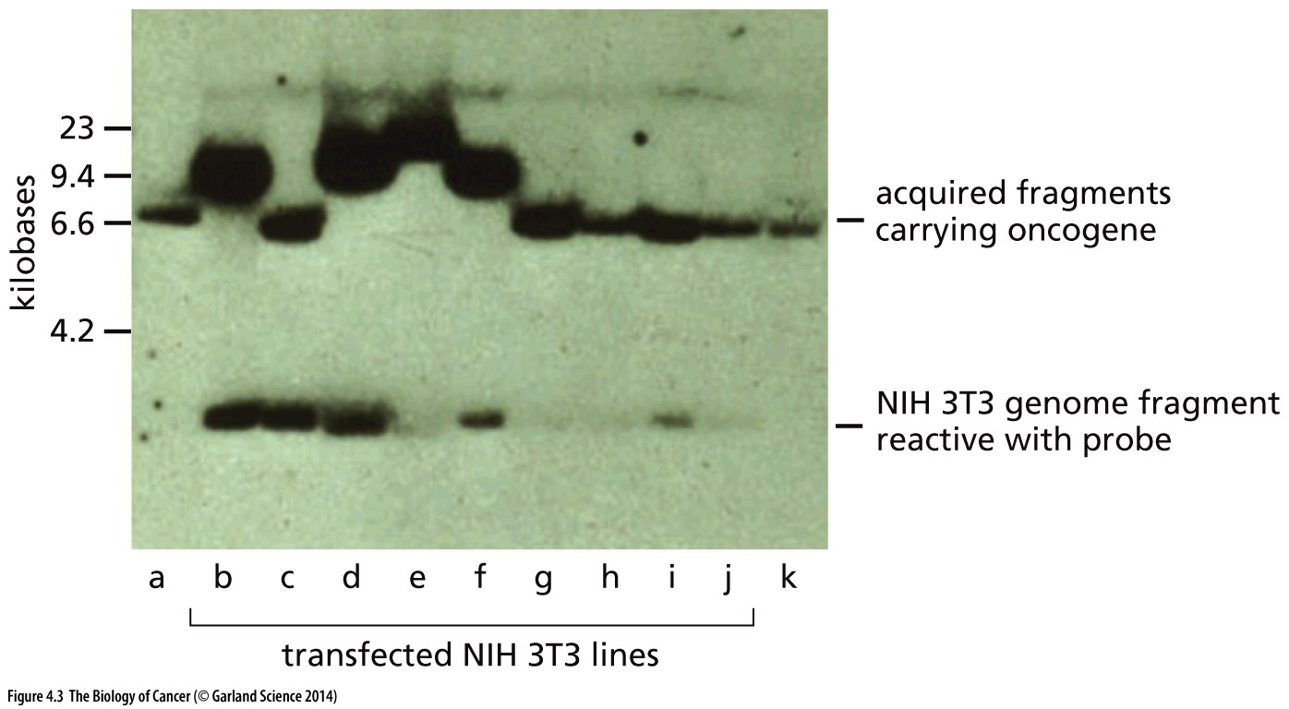
Figure 4.3 Homology between transfected oncogenes and retroviral oncogenes
Southern blot:
Shown here is the annealing between a radiolabeled H-ras oncogene probe (cloned from the genome of Harvey murine sarcoma virus) and the genomic DNAs from a series of nine lines of NIH 3T3 cells (lanes b–j) that had been transformed by transfection of DNA extracted from the EJ human bladder carcinoma cell line;

Slide 26
Nature. 1982 Jun 10;297(5866):474-8.
Human EJ bladder carcinoma oncogene is homologue of Harvey sarcoma virus ras gene.
Parada LF, Tabin CJ, Shih C, Weinberg RA.
Abstract
Examination of homologies between retroviral oncogenes and transforming sequences defined by transfection reveals that the human bladder carcinoma (EJ) oncogene is homologous to the Harvey sarcoma virus oncogene (ras). Structural analysis limits the region of homology to a 3.0-kilobase SacI fragment of the EJ oncogene. Both EJ and ras DNA probes detect similar transcripts in transfectants derived from bladdercarcinoma cell lines.
Robert Weinberg (author of this text book) is best known for his cloning of the human oncogene Ras and the tumor suppressor gene Rb; In addition, the famous review paper: "The Hallmarks of Cancer"

Slide 27
Significance of Weinberg Experiment
Weinberg experiment:
Human cancer use similar oncogene as virus oncogene to become transformed.
Varmus-Bishop experiment
Normal cell have a copy of virus oncogene, albert in inactive form (proto-oncogene).

Slide 28
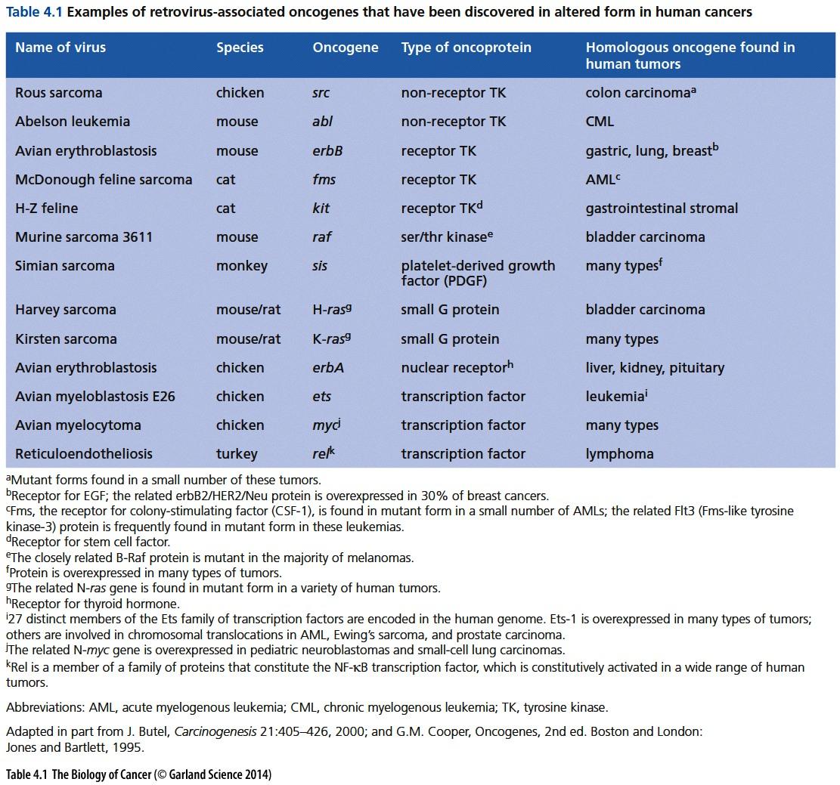
Notes:
几乎所有重要的oncogene都在致癌的逆转录病毒中发现，经典的如myc, ras, erbB…

Slide 29
myc oncogene
The myc oncogene, originally known from its presence in avian myelocytomatosis (髓细胞增生) virus (AMV) was found to be present in multiple copies in the DNA of the HL-60 human promyelocytic leukemia cell line. These extra copies of the myc gene (about 10–20 per diploid genome) were the result of the process of gene amplification
Notes:
Myc是最强的诱发人类肿瘤的癌基因。Myc是myelocytomatosis的缩写，myc最早也是从致癌病毒中发现的。

Slide 30
erbB oncogene
The erbB gene, first discovered through its presence in the genome of avian erythroblastosis virus (AEV), was discovered to be present in increased copy number in the DNAs of human stomach, breast, and brain tumor cells. Elevated expression of the homolog of the erbB gene is now thought to be present in the majority of human carcinomas. In 1987, amplification of the erbB-related gene known variously as erbB2, neu, or HER2 was reported in many breast cancers (Figure 4.4A).
The ErbB family of proteins contains four receptor tyrosine kinases, structurally related to the epidermal growth factor receptor (EGFR), its first discovered member. In humans, the family includes Her1 (EGFR, ErbB1), Her2 (Neu, ErbB2), Her3 (ErbB3), and Her4 (ErbB4).
Notes:
下一次课主要讲 erbB 这个oncogene致癌的分子机理……

Slide 31
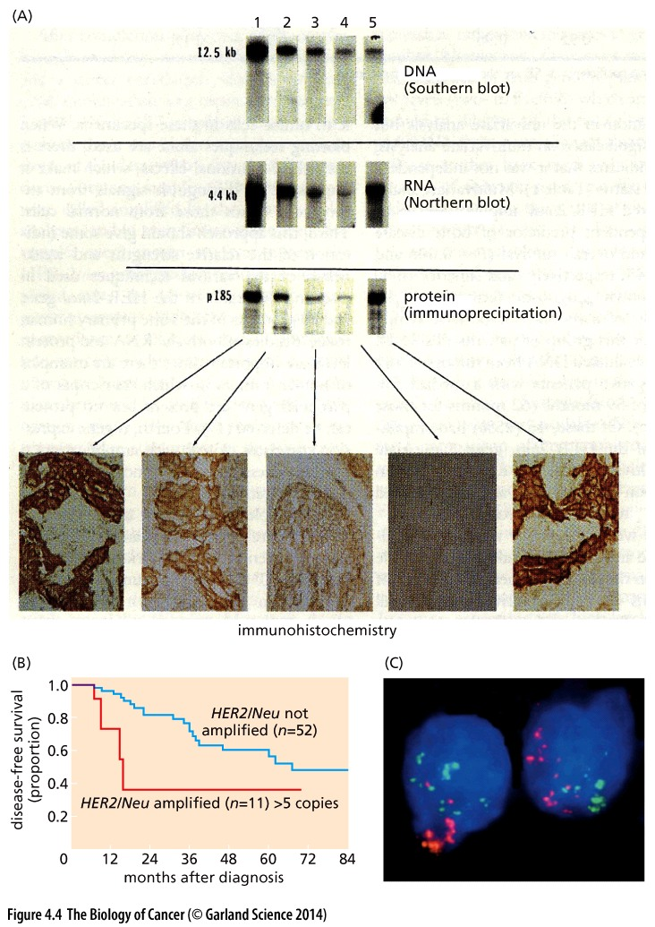
Figure 4.4 Amplification of the erbB2/HER2/neu oncogene in breast cancers

Slide 32
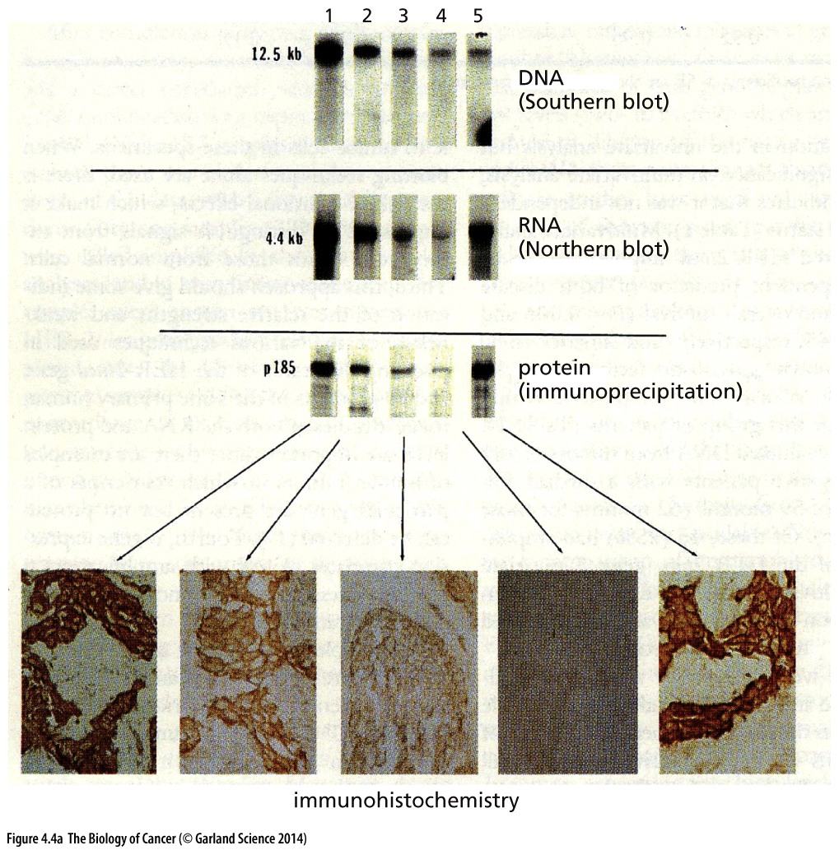
(A) The Southern blotting procedure was used to determine whether the DNA of five human breast carcinomas carried extra (that is, amplified) copies of the erbB2/ neu oncogene (also termed HER2), a close relative of the erbB oncogene.

Slide 33
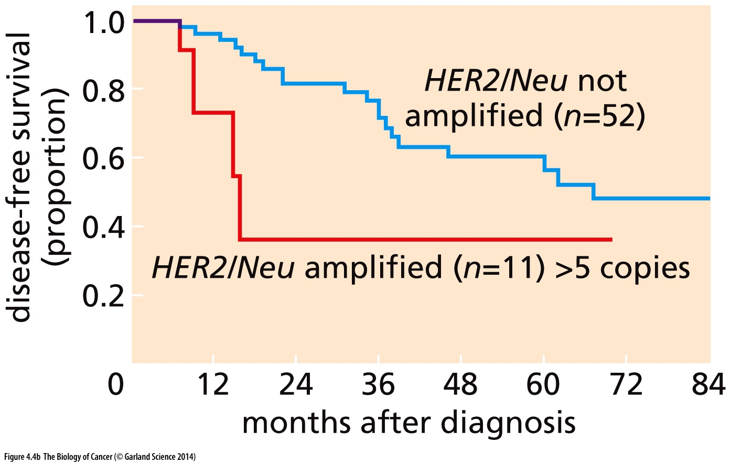
Kaplan-Meier plots
(B) This gene amplification is correlated with a poor prognosis for the breast cancer patient, as indicated by this Kaplan– Meier plot.
Notes:
临床研究经常使用到的统计表现方法

Slide 34
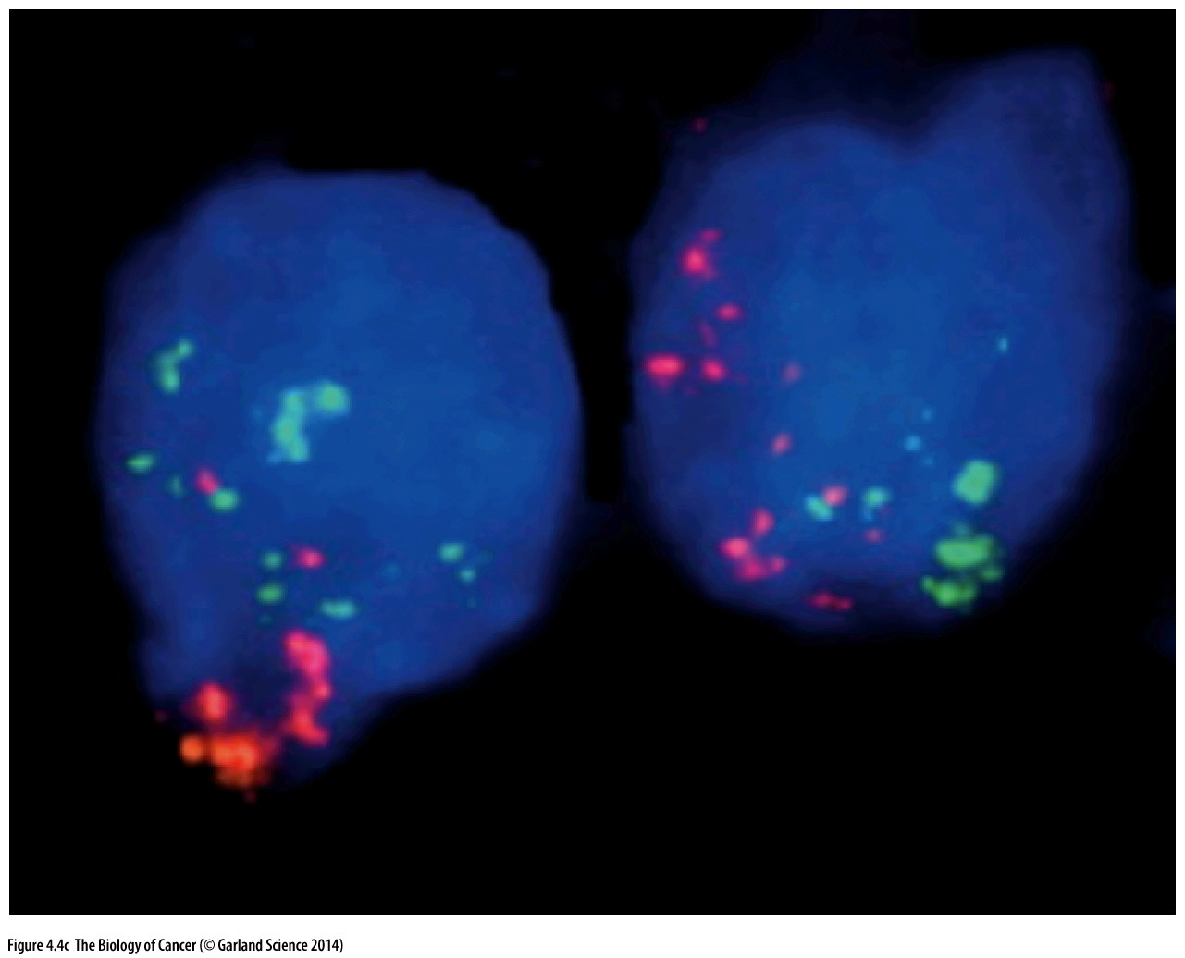
FISH to detect gene copy number alteration
(C) Use of fluorescence in situ hybridization (FISH) has shown that in some human breast cancers, there are multiple spots in each cell nucleus that react with a fluorescence-labeled DNA probe that recognizes the erbB2/HER2 gene (light green) and yet other spots that react with a DNA probe specific for the CCND1/cyclin D1 gene (orange/pink). Each of these probes generates only two spots when used to analyze nuclei of normal diploid cells.
Notes:
FISH的大概原理介绍，操作方法。。。

Slide 35
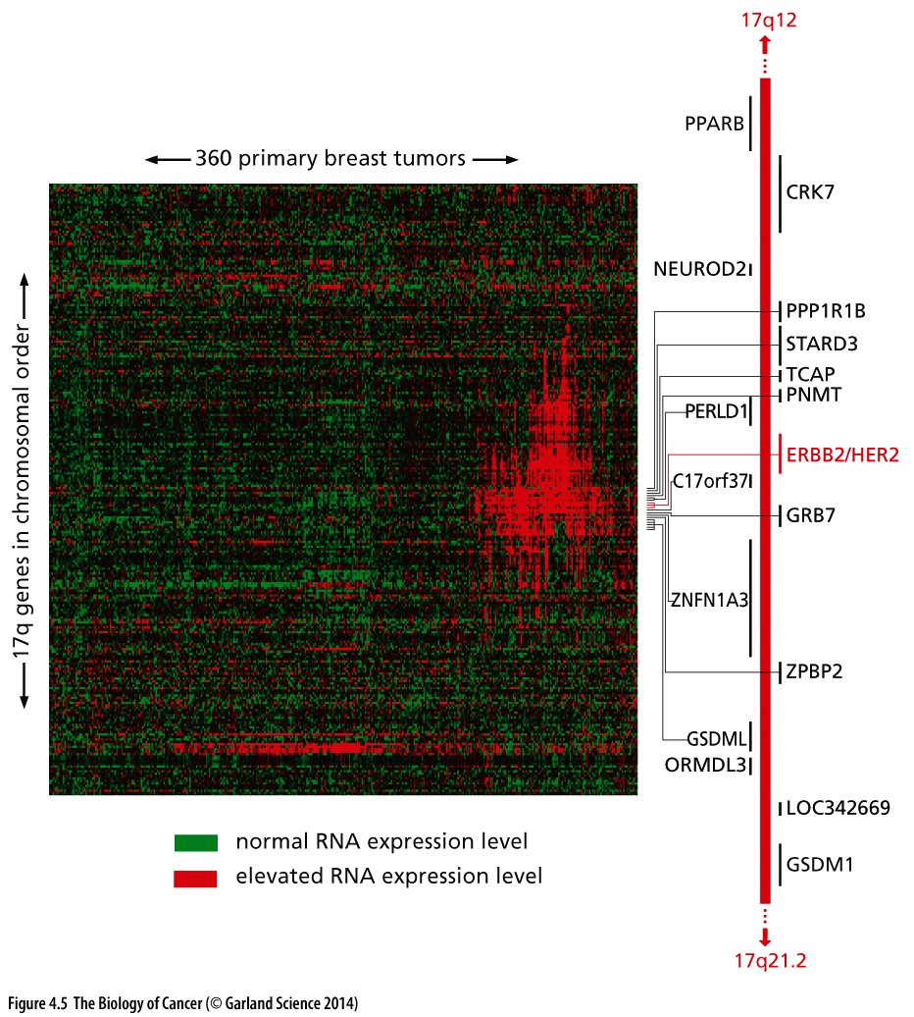
Figure 4.5 Elevated expression of 17q genes together with overexpression of erbB2/HER2
The amplification of a gene, such as erbB2/HER2, occurs as a consequence of the amplification of an entire chromosomal segment— an amplicon—that usually extends beyond this gene on both sides for several megabases. Because an amplicon of this size encompasses many additional genes, these other genes will also be amplified and some of them may also affect tumor cell phenotype (in this case that of breast cancer cells).
Notes:
肿瘤中实际扩增的情况，要大于erbB这一个基因, 基因组拷贝数变异（copy number variation）的一个实例。

Slide 36
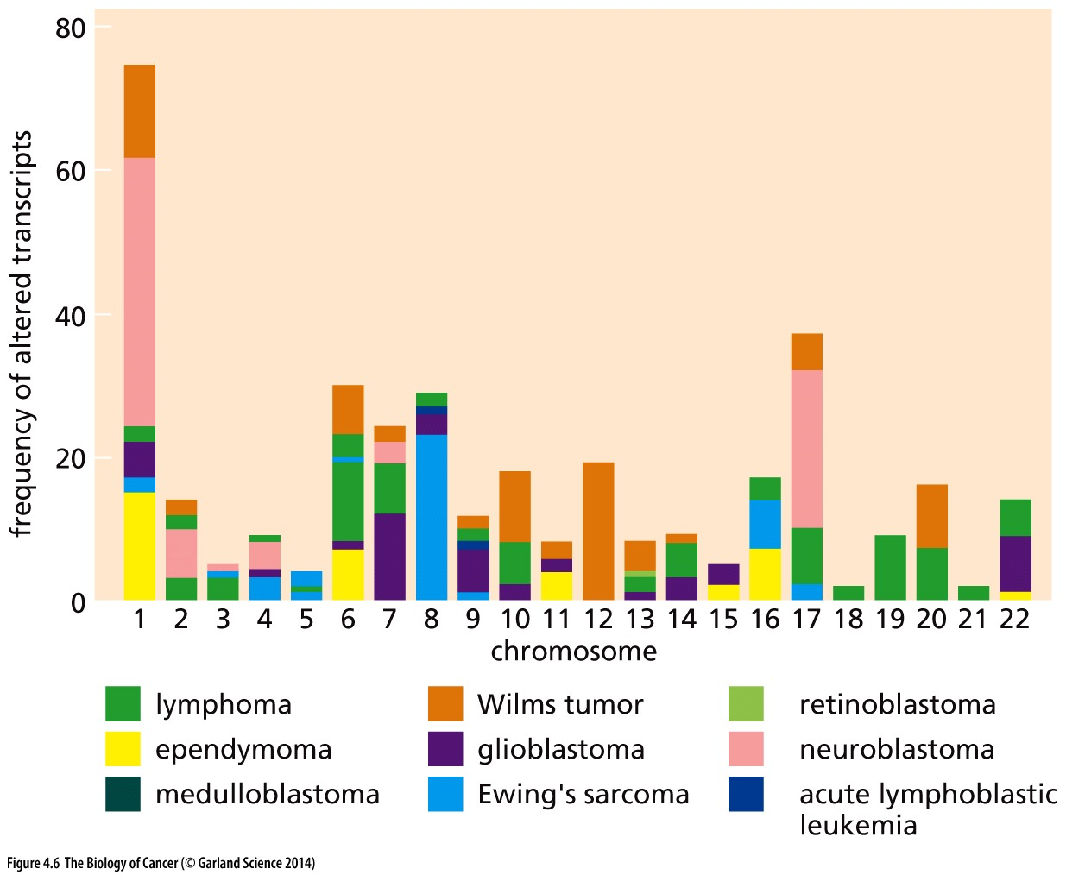
Figure 4.6 Nonrandom amplifications and deletions of chromosomal regions
Different cell types undergo distinct sets of genomic alterations during their transformation into full fledged tumor cells.
Notes:
肿瘤异质性，不同肿瘤有不同扩增、删剪染色体DNA区域。拷贝数变异（copy number variation）是肿瘤基因组研究的一个难点，很多明显的问题未解决！

Slide 37
4.4 Proto-oncogenes can be activated by genetic changes affecting either protein expression or structure

Slide 38
But how did a normal human H-ras proto-oncogene become converted into the potent oncogene?
H-ras gene is not amplified…
Cloning of H-ras oncogene…

Slide 39
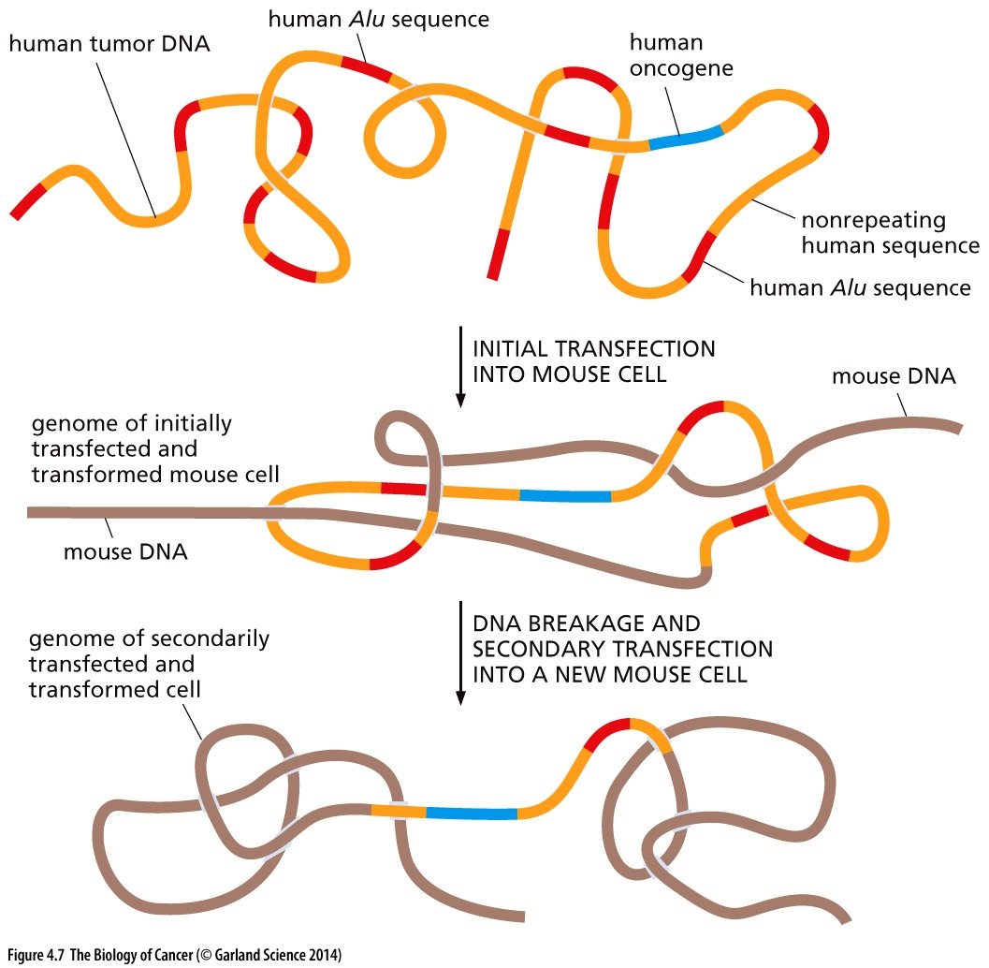
Figure 4.7 Cloning of transfected human oncogenes
This strategy for cloning the oncogene present in a human bladder carcinoma depended on Alu sequences (red segments), which are present in almost a million copies scattered throughout the human genome (orange segments). As a consequence, virtually all human genes are closely linked to one or more of the Alu sequences. If the genomic DNA of a human tumor cell bearing an oncogene (blue segment) is transfected into a mouse cell [whose DNA (light brown line) lacks sequences closely related to human Alu sequences], the introduced human DNA can be detected by use of an Alu-specific probe in the Southern blotting procedure. Only about 0.1% of the donor DNA genome became established in the initially transfected, transformed mouse cells, indicating that these cells carried both the transforming oncogene and perhaps 103 co-transfected human Alu sequences. Because so many human Alu sequences were co-introduced with the human oncogene into these cells, the DNA of cells descended from them was extracted, fragmented, and used in a second cycle of transfection into mouse cells. Once again, only about 0.1% of the donor DNA (from the initially transfected cells) survived in the secondary transfectants, dictating that the only human DNA and associated Alu sequences that were present in the secondarily transformed cells were those that were closely linked to the human oncogene (whose presence was detected because of the transformed phenotype that it caused in these cells). A genomic library could then be made from the DNA of these secondary transformants, and the DNA clone containing the bladder carcinoma oncogene could be identified (using an Alu- specific probe) and retrieved.

Slide 40
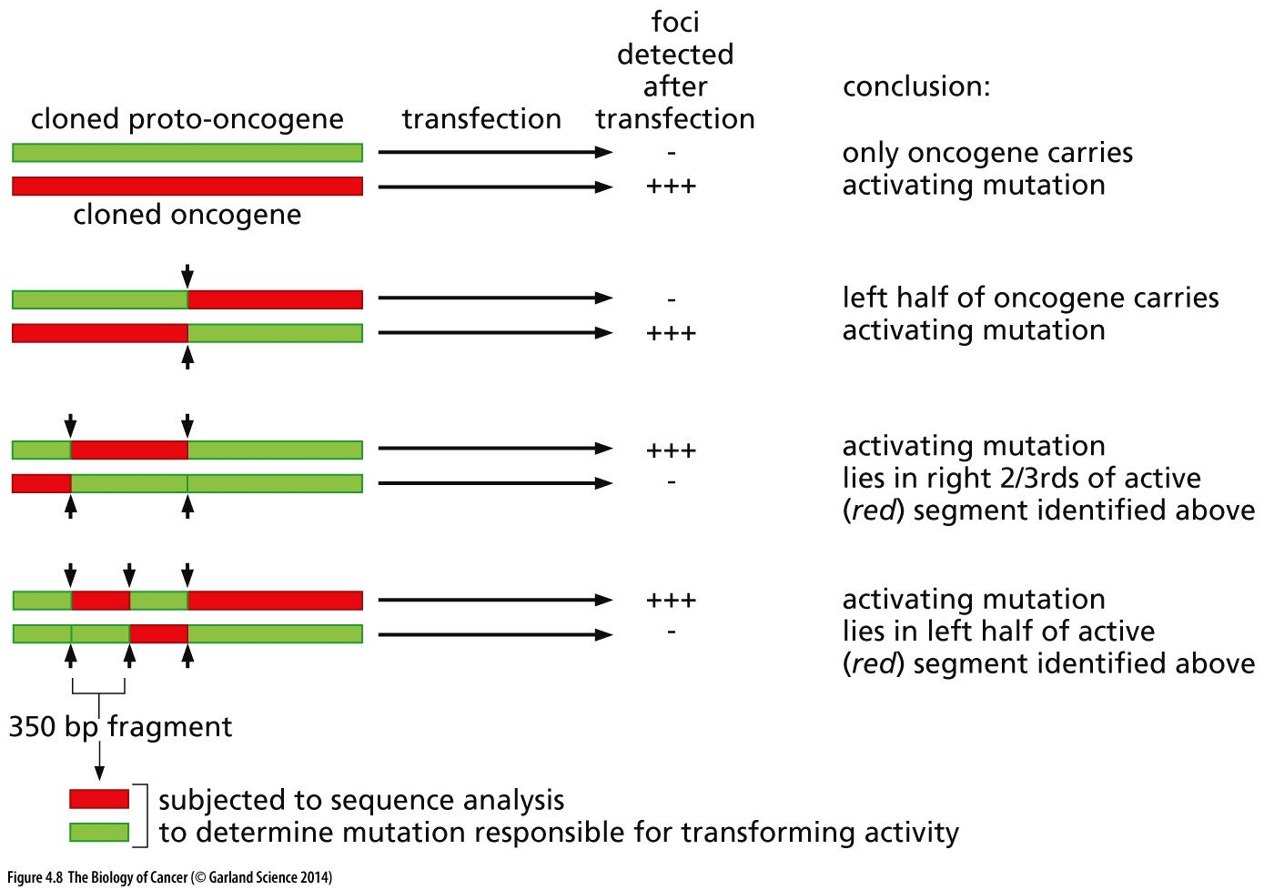
Figure 4.8 Localization of an oncogene-activating mutation
The cloned DNAs of a human bladder carcinoma oncogene (red segments) and the closely related human H-ras proto-oncogene (green segments) were cleaved by restriction enzymes at the sites indicated (vertical arrows) and recombinant genes were made by ligating (linking) the resulting DNA fragments from the two sources and testing the hybrid DNA molecules for their transforming activity using the transfection-focus assay (see Figure 4.1). This made it possible to progressively localize the mutation responsible for oncogene activation to a small 350-basepair segment, which could then be subjected to sequence analysis in order to determine the precise sequence change that distinguishes the two allelic versions of this gene.
Early 1980s
Notes:
古老、过时的方法

Slide 41
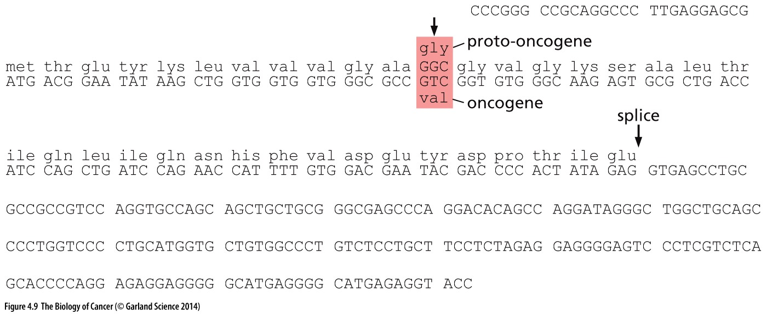
Figure 4.9 Mutation responsible for H-ras oncogene activation
The critical difference between the human bladder carcinoma oncogene and its proto-oncogene could be localized to a subgenic fragment of 350 base pairs. The sequences of the two 350-nucleotide-long DNA fragments from the oncogene and proto-oncogene were then determined. The two differed at a single nucleotide, which affected the 12th codon of the H-ras reading frame (arrow), converting the normally present glycine-encoding codon to one specifying valine.

Slide 42
The discovery of this point mutation represented a significant milestone in cancer research. It was the first time that a mutation was discovered in a gene that contributed causally to the neoplastic growth of a human cancer. Equally important, it seemed that this genetic change arose as a somatic mutation.
Implications for cancer genomics study…

Slide 43
With this information in hand, researchers could devise a likely explanation for the origin of the bladder carcinoma and, by extension, other similar tumors. The particular bladder carcinoma from which the H-ras oncogene had been cloned was said to have arisen in a middle-aged man who had been smoking for four decades. During this time, carcinogens present in cigarette smoke were introduced in large amounts into his lungs and passed from there through the bloodstream to his kidneys, which excreted these chemical species with the urine. While in the bladder, some of the carcinogen molecules present in the urine had entered cells lining the bladder and attacked their DNA. On one occasion, a mutagenic carcinogen introduced a point mutation in the H-ras proto-oncogene of an epithelial cell. Thereafter, this mutant cell and its descendants proliferated uncontrollably, being driven by the potent transforming action of the H-ras oncogene that they carried. The result, years later, was the large tumor mass that was eventually diagnosed in this patient.
Notes:
依据试验结果进行的推测……

Slide 44
Ras gene family
Within a decade, a large number of human tumors were found that carried point mutations in one of the three ras genes present in the mammalian genome: H-ras, K-ras, and N-ras. Significantly, in each of these tumors, the point mutation that was uncovered was present in one of three specific codons in the reading frame of a ras gene. Consequently, all Ras oncoproteins (whether made by the H-, K-, or N-ras gene) were found to carry amino acid substitutions in residue 12 or, less frequently, residues 13 and 61 (Figure 4.10).

Slide 45
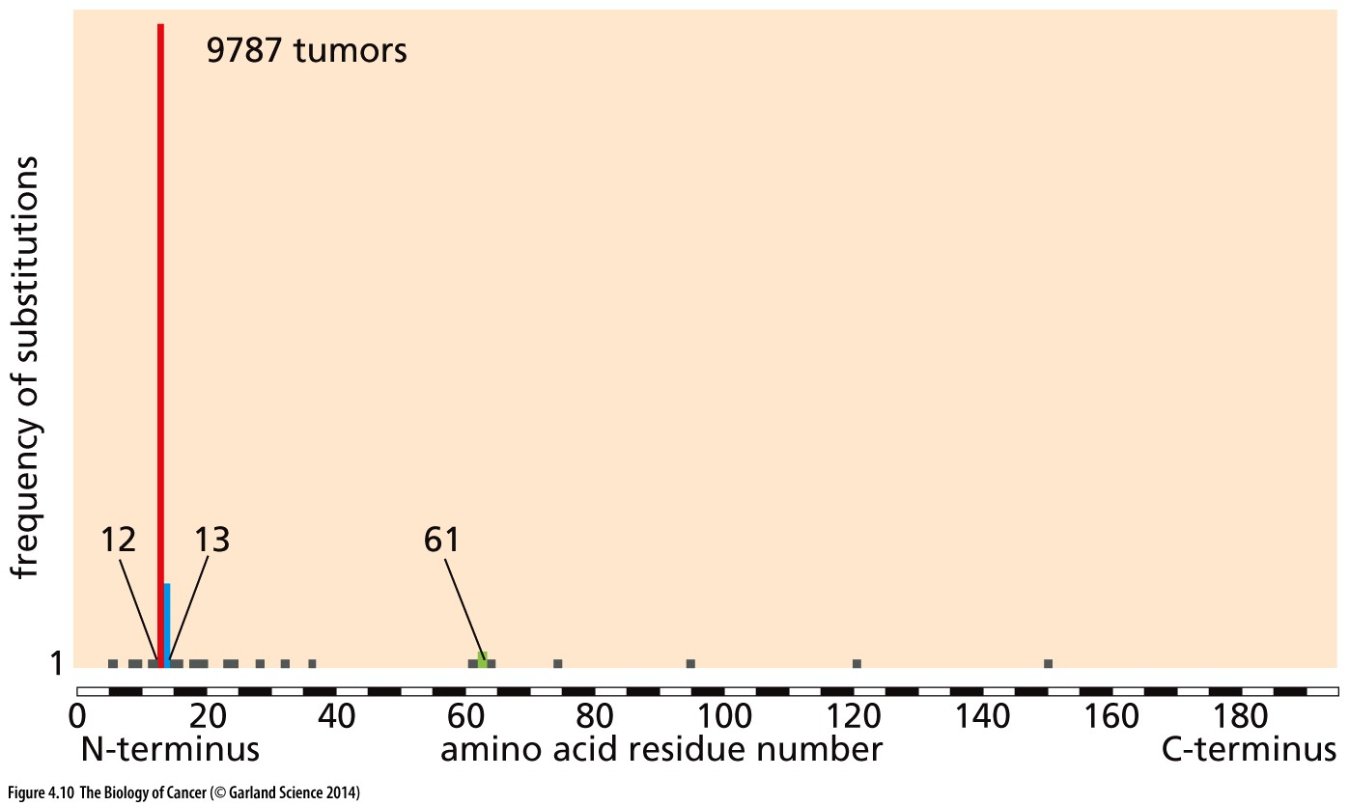
Figure 4.10 Concentration of point mutations leading to activation of the K-ras oncogene
Since all the codons of the K-ras reading frame are likely to suffer mutations at comparable rates during tumor development, this suggests that an extraordinarily strong selective pressure favors the outgrowth of cells having mutations affecting codons 12, 13,and 61.
Cancer driver mutation
Cancer passenger mutation
Notes:
Goal of Cancer genomics study: separate cancer driving mutation from passenger mutation.

Slide 46
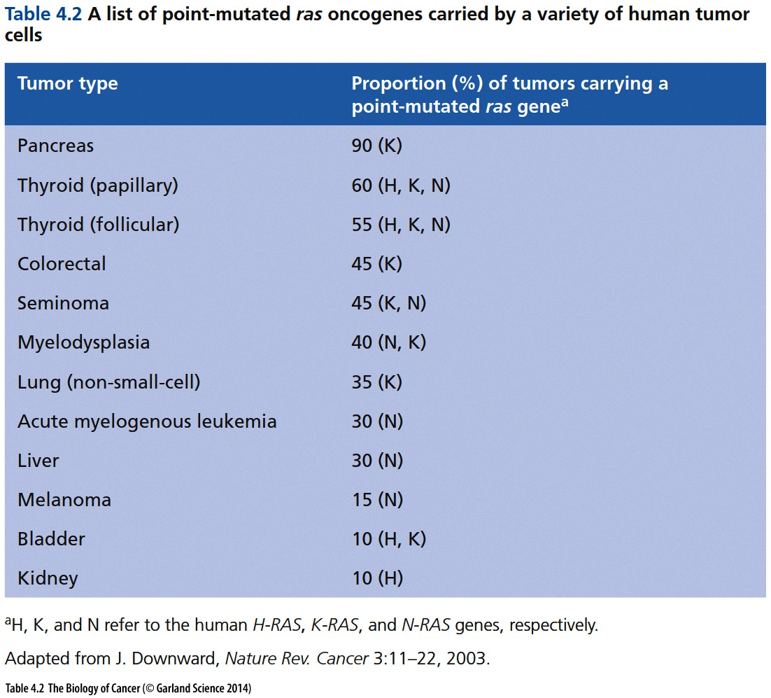

Slide 47
Why different tissues use different Ras gene mutation to initiate cancer?
For unknown reasons, the frequency with which these mutant oncogenes are found varies dramatically from one tissue site to another (Table 4.2). One clue, however, has come from genetically engineered mice in which the reading frame of the K-ras protooncogene has been replaced (“knocked-in”; see Supplementary Sidebar 7.7) with the reading frame of an H-ras oncogene. Wild-type mice usually develop lung tumors carrying K-ras oncogenes in response to treatment by a chemical carcinogen; however, the vast majority of the knock-in mice develop lung tumors carrying H-ras oncogenes following this treatment. This indicates that the regulatory sequences controlling the expression of the K-ras proto-oncogene, rather than the structure of the encoded protein, determine which ras proto-oncogene becomes activated in response to a mutagenic carcinogen.
Possibly other reasons…

Slide 48
2nd way to activate cellular proto-oncogene
Gene amplification

Slide 49
4.5 Variations on a theme: the myc oncogene can arise via at least three additional distinct mechanisms

Slide 50
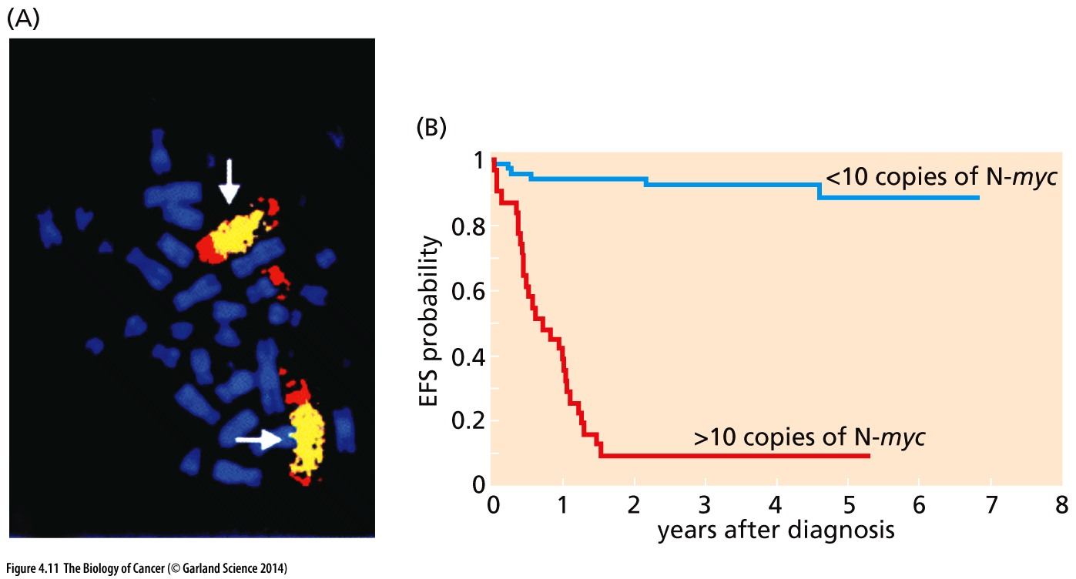
Figure 4.11 N-myc amplification and neuroblastoma prognosis

Slide 51
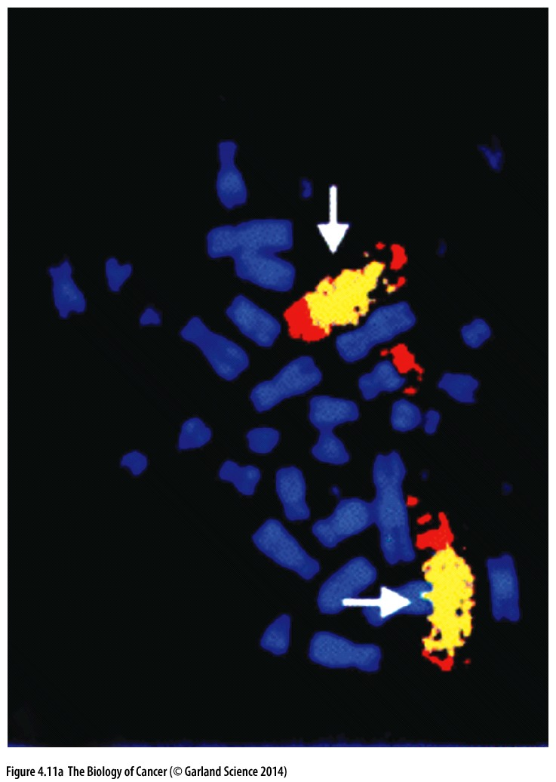
Figure 4.11 N-myc amplification and neuroblastoma prognosis
The N-myc gene is often amplified in human childhood neuroblastomas. Here, use of fluorescence in situ hybridization (FISH) has revealed multiple copies of this gene (yellow). The fact that these N-myc gene copies are present as tandem arrays within chromosomes means that they constitute homogeneous staining regions (HSRs) rather than extrachromosomal particles—double minutes (DMs)—which are also frequently seen in these tumors.

Slide 52
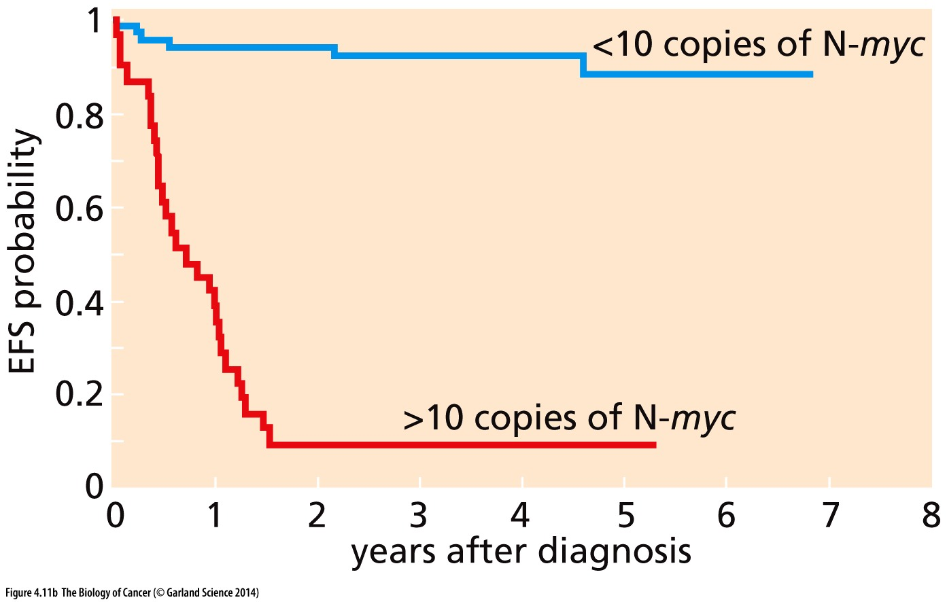
Figure 4.11 N-myc amplification and neuroblastoma prognosis
This Kaplan–Meier plot illustrates the event-free survival (EFS) of children suffering from neuroblastoma, that is, no clinically significant cancer-related symptoms in the indicated years following initial diagnosis and treatment. Those whose tumor cells have minimal or no N-myc amplification have a very good prognosis and minimal clinical events, while those whose tumors have extensive N-myc amplification have a dramatically poorer prognosis and therefore short survival times after diagnosis.

Slide 53
The gene amplification process, which is responsible for increases in myc copy number, occurs through the preferential replication of a limited region of chromosomal DNA,
leaving the more distantly located chromosomal regions unaffected (see Figure 4.5). Since the region of chromosomal DNA that undergoes amplification—the amplicon— usually includes a stretch of DNA far longer than the c-myc or N-myc gene (for example, typically including 0.5 to 10 megabases of DNA), the amplified chromosomal regions are often large enough to be observed at the metaphase of mitosis through a light microscope. Often gene amplification yields large, repeating end-to-end linear arrays of the chromosomal region, which appear as homogeneously staining regions (HSRs) in the microscope (see Figure 1.12A). Alternatively, the chromosomal region carrying a myc or N-myc gene may break away from the chromosome and can be seen as small, independently replicating, extrachromosomal particles (double minutes; see Figure 1.12B,C). Indeed, we now know that a number of proto-oncogenes can be found in amplified gene copy number in various types of human tumors (Table 4.3).

Slide 54
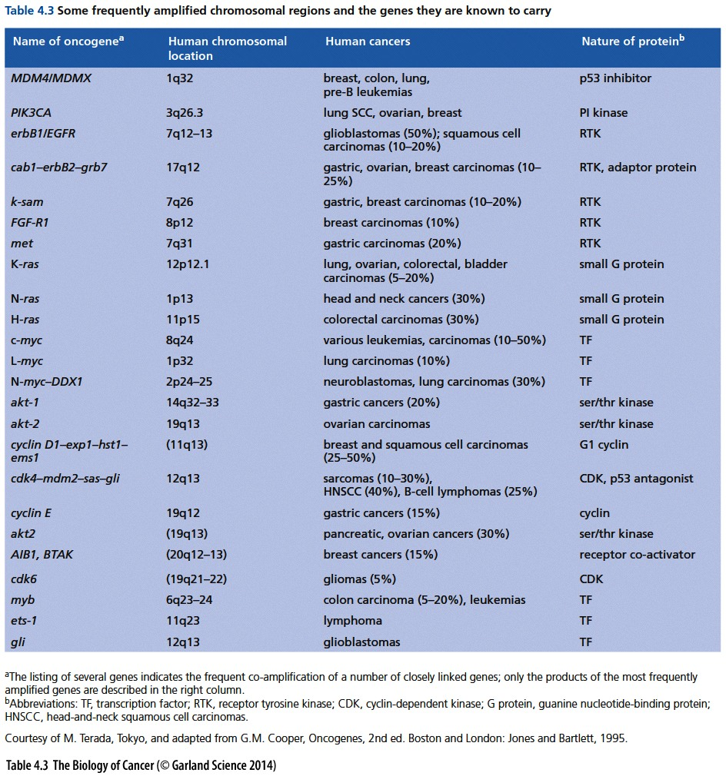

Slide 55
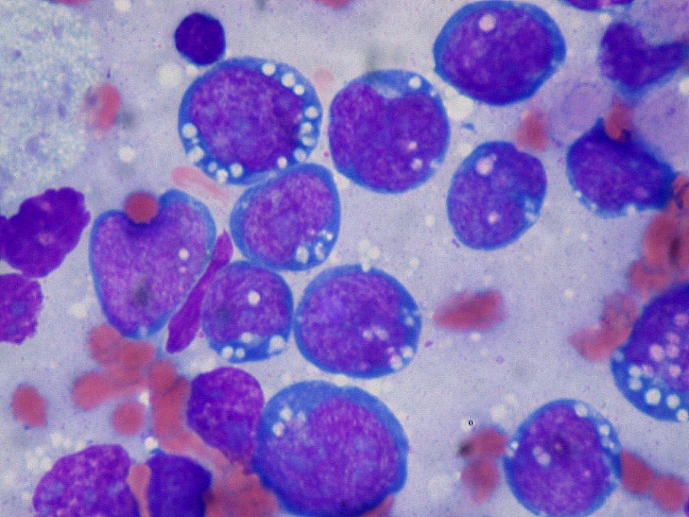
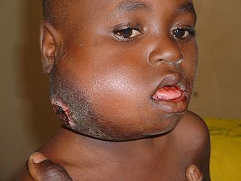
3rd way to activate cellular proto-oncogene
Strong promoter
Myc gene translocation and activation
Example:
Burkitt’s lymphoma （伯基特氏淋巴瘤）
Notes:
主要发病人群是小孩，成人少见。

Slide 56
Burkitt’s lymphoma
In the disease of Burkitt’s lymphoma (BL), this principle was validated in a most dramatic way. This tumor occurs with some frequency among young children in East and Central Africa (Figure 4.12). The etiologic agents of this disease include chronic infections both by Epstein–Barr virus (EBV, a distant relative of human herpes viruses（疱疹病毒）; Section 3.4) and by malarial parasites.
All types of Burkitt’s lymphoma are characterized by dysregulation of the c-myc gene by one of three chromosomal translocations.
Notes:
Epstein–Barr virus （EBV） is one of the most common human viruses. EBV is found all over the world. Most people get infected with EBV at some point in their lives. EBV is about 122–180 nm in diameter and is composed of a double helix of deoxyribonucleic acid (DNA) which contains about 172,000 base pairs encoding 85 genes.

Slide 57
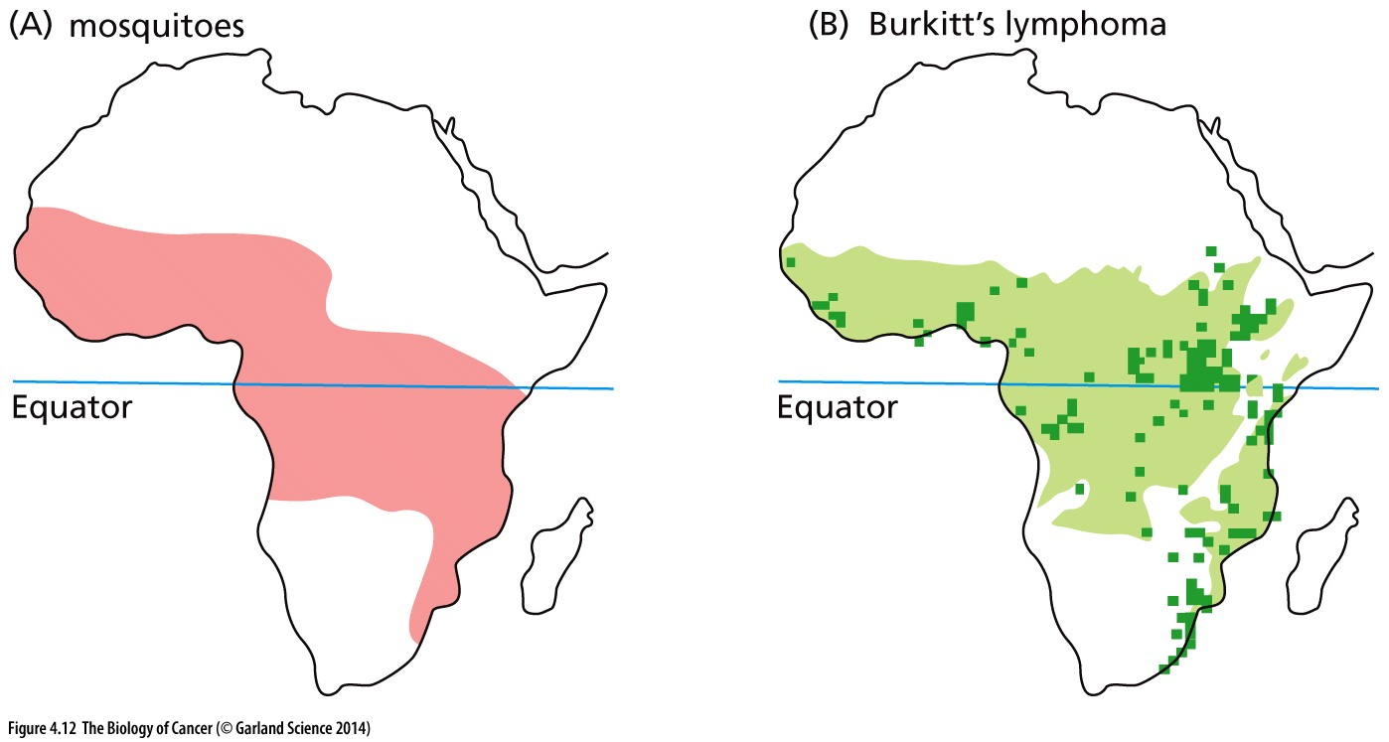
Figure 4.12 Burkitt’s lymphoma incidence in Africa
(A) The geographic distribution in Africa of the Anopheles gambiae mosquito, a known vector in the transmission of malaria. (B) The geographic distribution of childhood Burkitt’s lymphoma (BL). The rough congruence of these two distribution maps suggested that malarial infection was likely an etiologic factor in this disease. In addition, the invariable presence of the Epstein–Barr virus (EBV) genome in the BL tumor cells indicates a second etiologic factor. As the tumor cells evolve, a chromosomal translocation involving the c-myc gene develops, which contributes to the neoplastic proliferation of the EBV-infected B lymphocytes.
Notes:
Of all cancers involving the same class of blood cell, 2.3% of cases are Burkitt lymphoma. Epstein-Barr virus infection is strongly correlated with this cancer

Slide 58
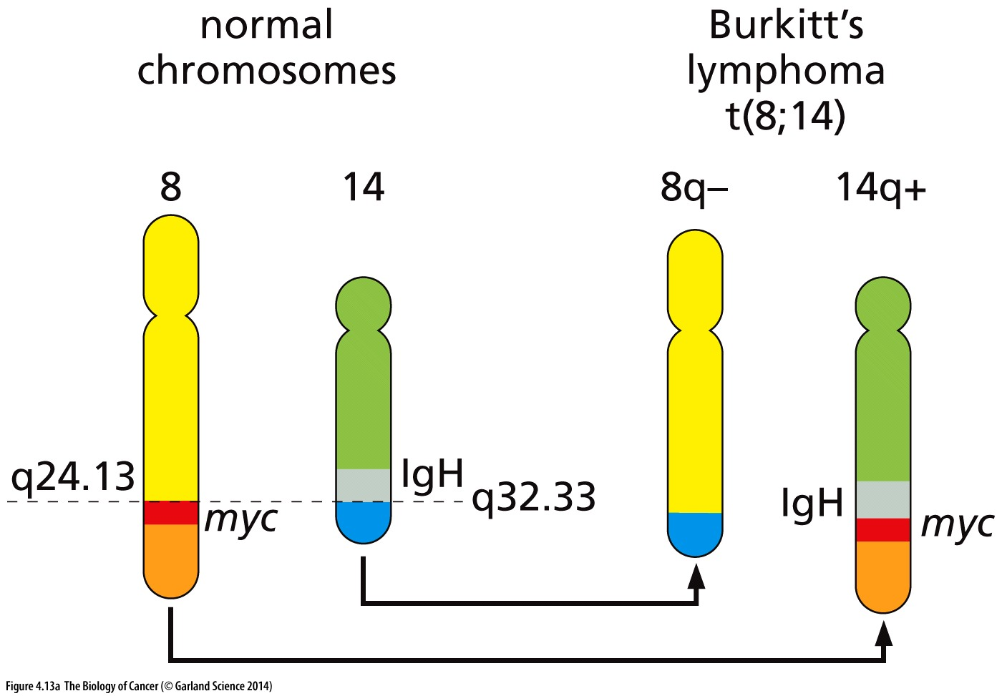
Figure 4.13 Chromosomal translocations in Burkitt’s lymphomas
(A) In the genomes of Burkitt’s lymphoma (BL) cells, the expression of the c-myc gene is placed under control of the transcription-controlling enhancer sequences of an immunoglobulin gene as a direct consequence of reciprocal chromosomal translocations. These translocations juxtapose immunoglobulin genes on Chromosomes 2, 14, or 22 with the myc gene on Chromosome 8. The most common translocation, t(8;14), is shown here.
All types of Burkitt’s lymphoma are characterized by dysregulation of the c-myc gene by one of three chromosomal translocations.

Slide 59
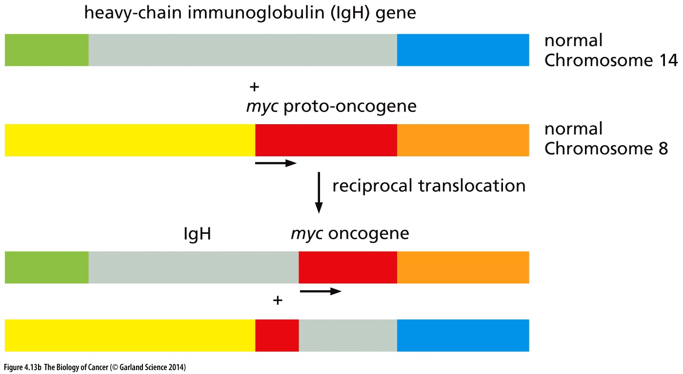
(B) Depicted is a genetic map of the translocation event that places the c-myc gene (red rectangle) on Chromosome 8 under the control of the immunoglobulin heavy-chain sequences (IgH; gray rectangle) on human Chromosome 14. Because the immunoglobulin enhancer sequences direct high, constitutive expression, the normal modulation of myc expression in response to physiologic signals is abrogated. The resulting myc oncogene initially makes structurally normal Myc protein but in abnormally high amounts.
Notes:
为什么Ｉｇ区域容易发生断裂？

Slide 60
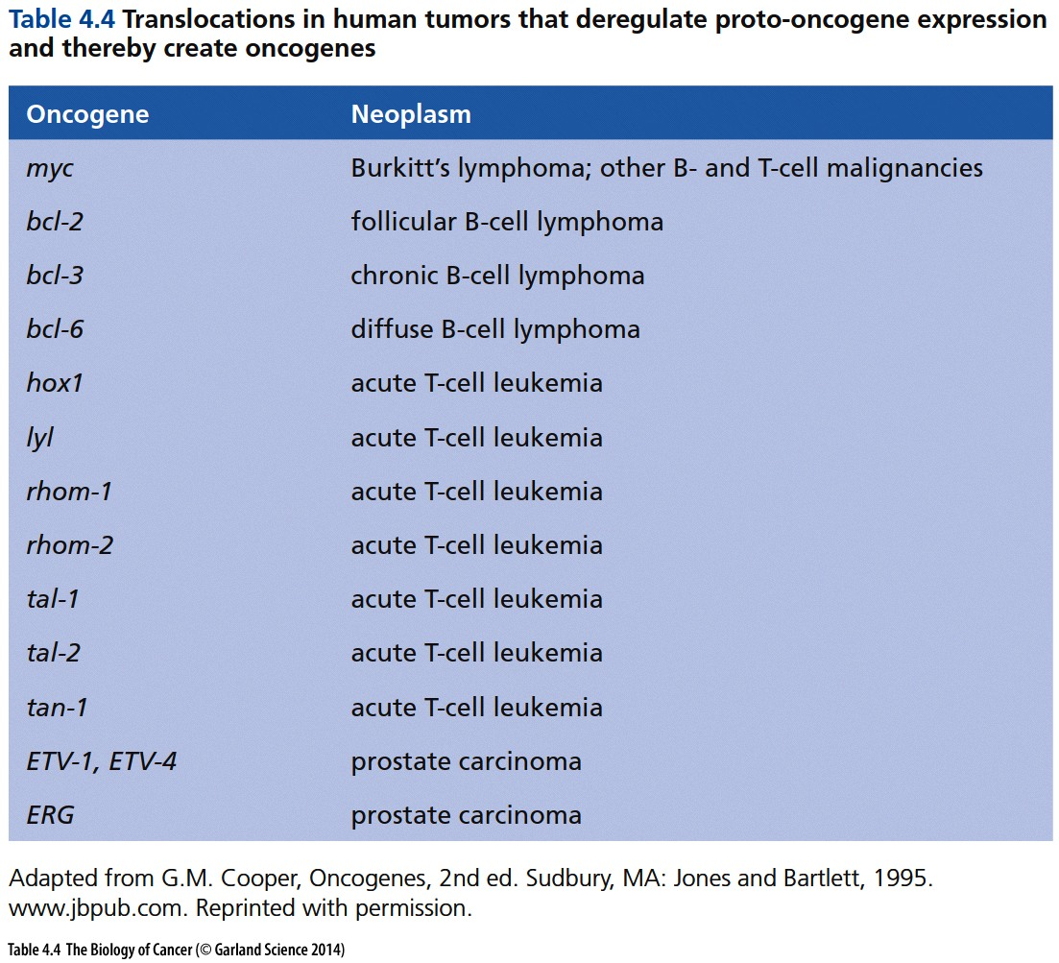
Notes:
在以前，所有的的肿瘤相关chromosome translocation发生在血液肿瘤，十年前发现的ERG基因在前列腺癌chromosome translocation是第一例 solid tumor case.

Slide 61
4.6 A diverse array of structural changes in proteins can also lead to oncogene activation

Slide 62
Deregulated firing of growth factor receptors Normally, growth factor receptors displayed on the plasma membrane of a cell release signals into the cell interior only when the extracellular domain of the receptor has bound the appropriate growth factor. However, if the extracellular domain of certain receptors is deleted because of a mutation in the receptor-encoding gene or alternative splicing of the receptor premRNA, the resulting truncated receptor protein then emits signals into the cell without binding its growth factor ligand.

Slide 63
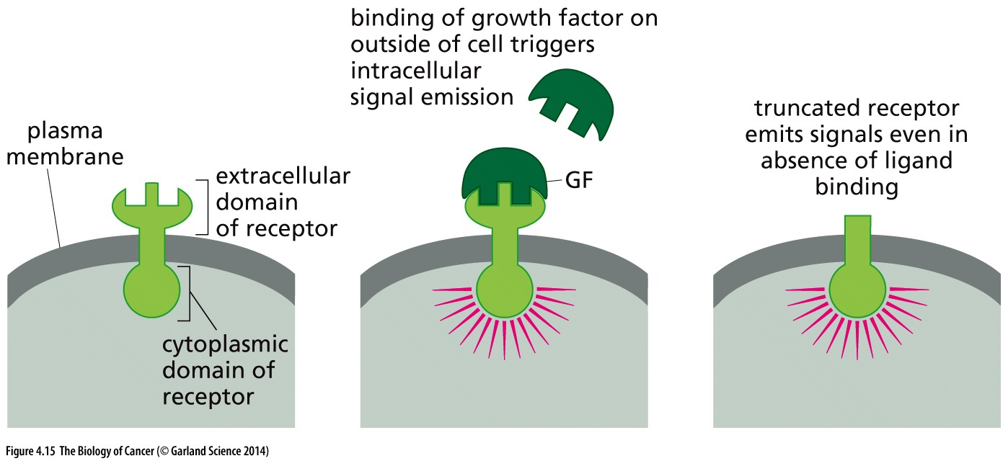
Figure 4.15 Deregulated firing of growth factor receptors
Notes:
erbB 是这类突变代表，后面章节提到

Slide 64
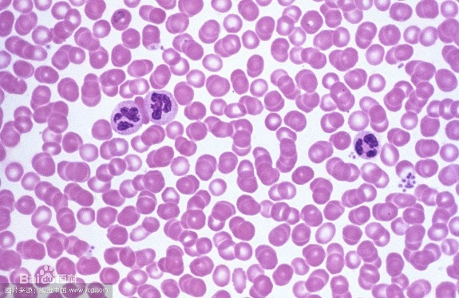
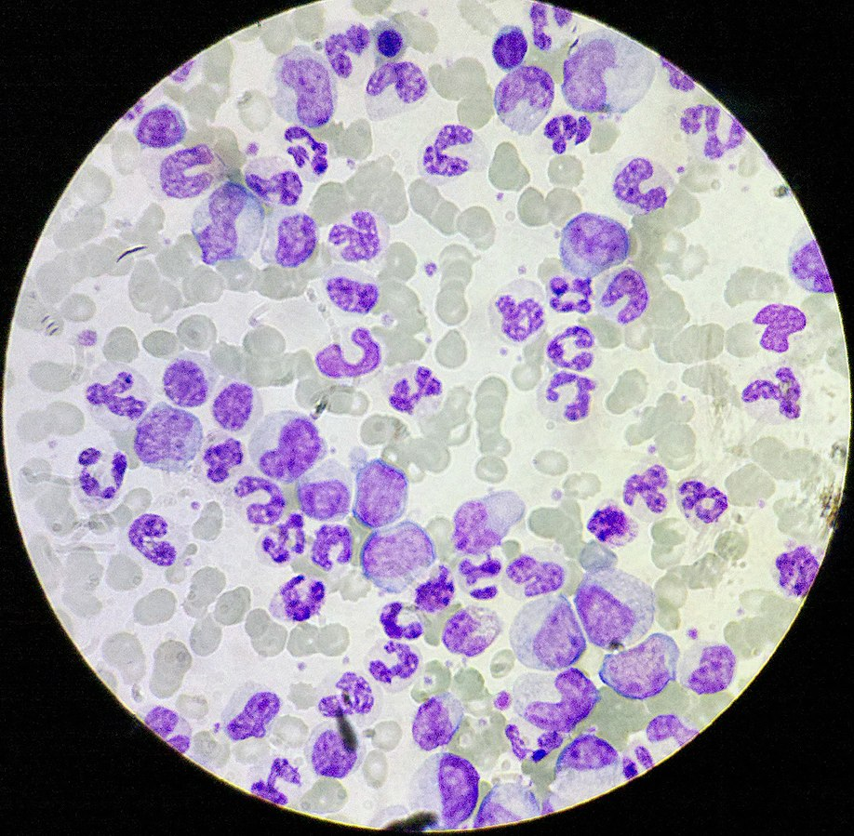
Chronic myelogenous leukemia (CML) and BCR-ABL
The chromosomal translocations cited in the previous section result, in one way or another, in deregulated expression of oncogenic proteins or microRNAs; even more common are translocations that lead to the formation of novel hybrid proteins. The best known of these are the chromosomal translocations found in more than 95% of the cases of chronic myelogenous leukemia (CML; see Figure 2.26).
超过95%的慢性粒细胞白血病（CML）肿瘤细胞含有BCR-ABL融合基因变异
正常外周血 CML
CML占成人白血病的20%；以50岁以上的人群最常见，平均发病年龄为65岁。
Notes:
一提到CML，我们就想到经典的肿瘤靶向治疗案例 imatinib

Slide 65
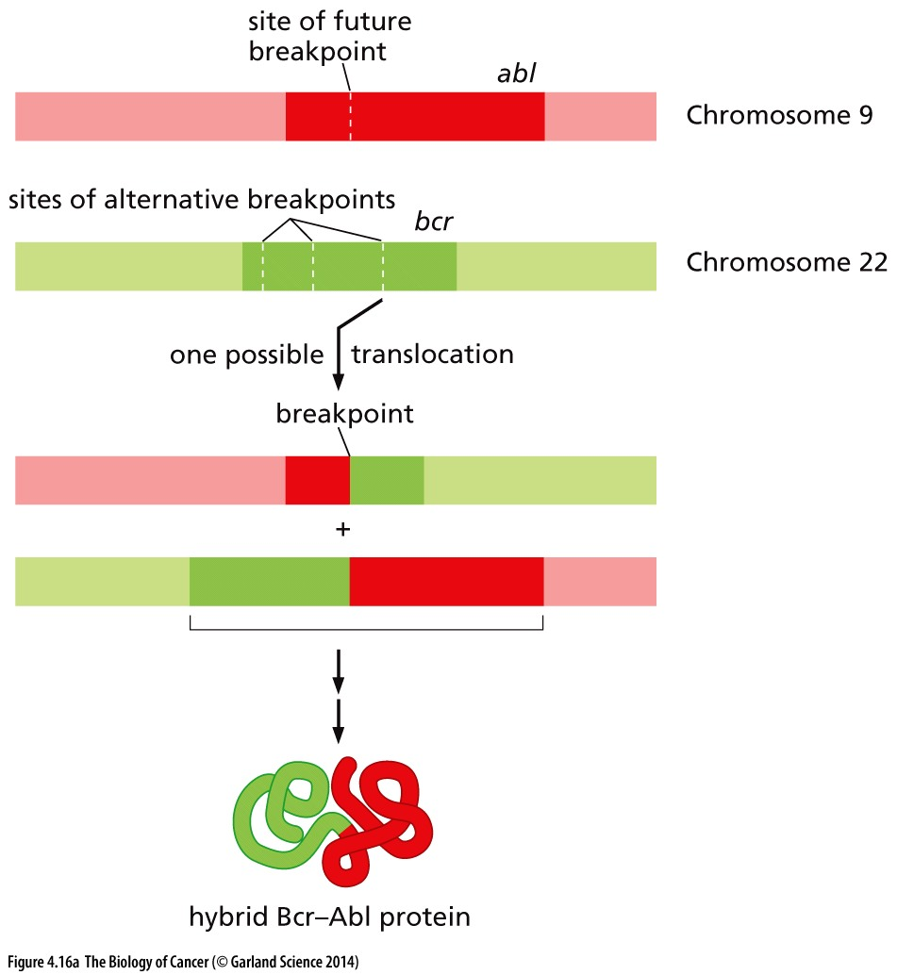
Figure 4.16 Formation of the bcr–abl oncogene
(A) Reciprocal chromosomal translocations between human Chromosomes 9 and 22, which carry the abl and bcr genes, respectively, result in the formation of fused, hybrid genes that encode hybrid Bcr–Abl proteins commonly found in chronic myelogenous leukemias (CML).

Slide 66
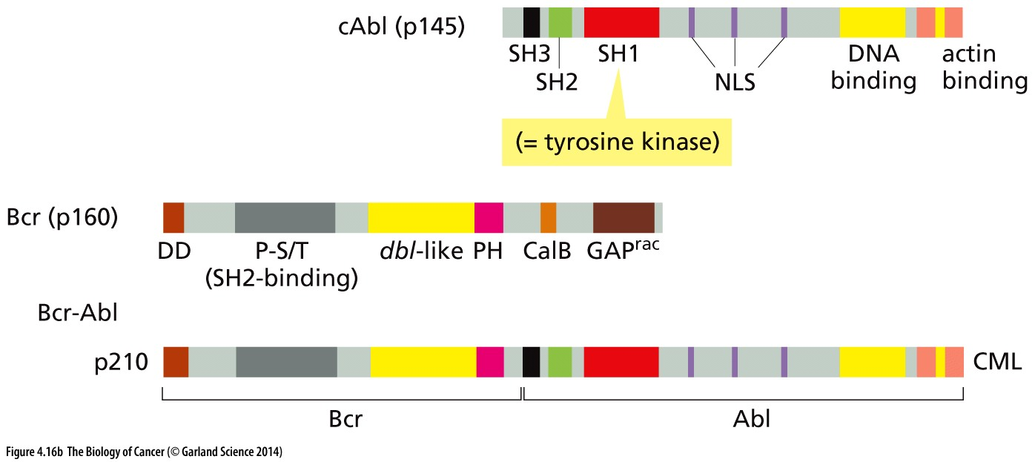
Figure 4.16 Formation of the bcr–abl oncogene
(B) The Bcr-Abl fusion causes deregulated firing of the tyrosine kinase of the fusion protein, which is equivalent to the SH1 domain; this firing (to be discussed in Section 6.3) is responsible for most of the transforming effects of the newly formed oncoprotein.

Slide 67
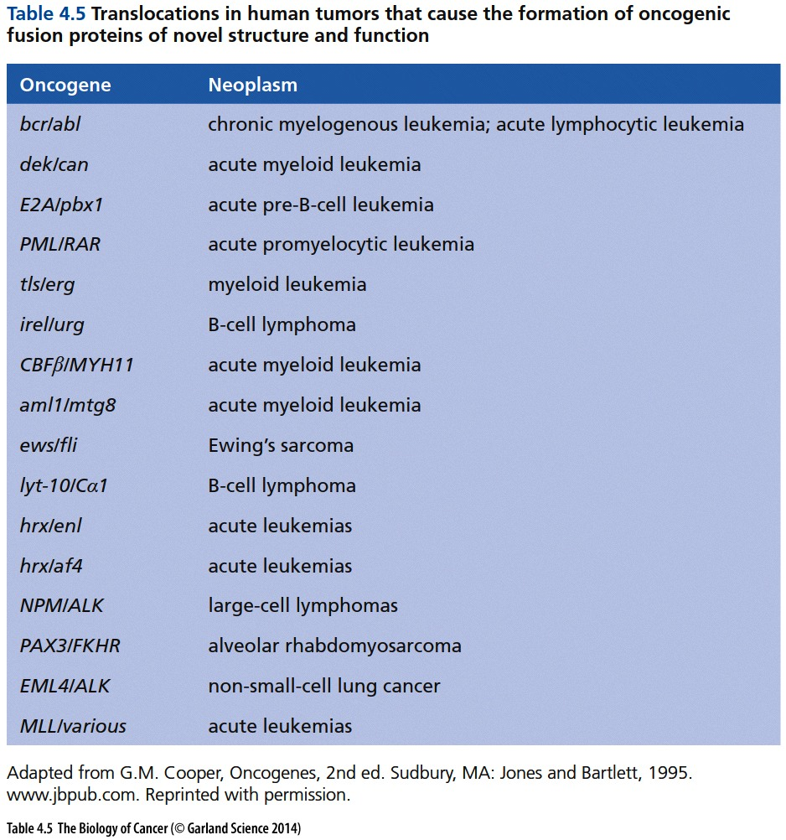
Notes:
关注 ｂｃｒ／ａｂｌ和 Ｐｍｌ／ＲＡＲＡ经典代表, 后者关注上海血研所的研究结果

Slide 68
TERT Promoter Mutations in Human Melanoma
Highly recurrent TERT promoter mutations in human melanoma.
Huang FW, Hodis E, Xu MJ, Kryukov GV, Chin L, Garraway LA.
Science. 2013 Feb 22;339(6122):957-9.

Slide 69
From proto-oncogene to oncogene
1, point mutation in coding region, K-RAS^{G12D}
2, gene amplification, MYC, ERBB
3, strong promoter after chromosome translocation, MYC in Burkitt`s lymphoma
4, protein structure changes, BCR-ABL
5, promoter mutation, TERT Promoter Mutations
Notes:
所有途径的共性：基因组DNA变异是主因；
DNA 变异又可归纳为两类：简单的点突变，复杂的基因拷贝数变异，染色体易位等。

